Slide 1
Essay Writing
Social Studies

Slide 2
Social essays
Social studies allows you to learn about the world… and then asks you, “what do you think?”
Essays allow you to express your thoughts and opinions in an organized, clear, logical manner.

Slide 3
Social essays: Types
Analysis Essay (Writing Assignment I)
You are given three sources (pictures, quotes, cartoons, etc.) and are asked to analyze them, and asked what relationships link the sources together
70 mins to write
Out of 20 marks
Persuasive Essay (Writing Assignment II)
You are given a quote and are asked, “To what extent should the ideological perspective(s) in the source be embraced?” This is basically asking you what your opinion is on the quote.
100 mins to write
Out of 30 marks

Slide 4
Social essays: Voice
Social -1 essays are written in a FORMAL VOICE.
Why?
You are trying to argue your position and intelligently analyze sources… so your writing needs to reflect these goals. Which of the following sentences would you take more seriously:
Globalization must be fully embraced as it offers numerous benefits to society; such as increased opportunities for trade and cultural sharing.
Globalization is awesome!!! It’s the best because it helps us make money and learn about each other. ☺

Slide 5
Social essays: Voice
Tips for writing in formal voice:
Remove first and second person references (I, we, you them)
Remove slang or offensive phrases
Remove “texting” or familiar tone
Remove imprecise or over-generalized vocabulary (stuff, a lot, thing, very, something, everything, always, never, you know, whatever)
Remove emotional responses to content. Find specific evidence that backs up your opinions.

Slide 6
Social essays: Voice
Exercise: Transform the following passages from informal to formal writing
You should go out with the kids and have an awesome time at the bash.
We couldn’t access the library since the librarian wasn’t in.
It was like, five bucks, so I was like, “okay.”

Slide 7
Essay Writing
Writing Assignment II:
The Persuasive Essay

Slide 8
Social essays: Types
Analysis Essay (Writing Assignment I)
You are given three sources (pictures, quotes, cartoons, etc.) and are asked to analyze them, and asked what relationships link the sources together
70 mins to write
Out of 20 marks
Persuasive Essay (Writing Assignment II)
You are given a quote and are asked, “To what extent should the ideological perspective(s) in the source be embraced?” This is basically asking you what your opinion is on the quote.
100 mins to write
Out of 30 marks

Slide 9
Writing Assignment II: Persuasion
Persuade: To cause someone to do something
Defend: To support an argument in the face of criticism; to prove the validity of an argument by answering questions put by a committee of specialists

Slide 10
This is what you will receive for Assignment II

Slide 11
Writing Assignment II: Overview
Introduction
Body Paragraphs
Grade 10: You will write 3 body paragraphs
Grade 11: You will write 3-4 body paragraphs
Grade 12: You will write 4 body paragraphs
Conclusion
Overall, you will write 5-6 paragraphs

Slide 12
Writing Assignment II: Overview
Paragraph 1: Introduction
Paragraph 2: Body Paragraph
Paragraph 3: Body Paragraph
Last Paragraph: Conclusion
Paragraph 4: Body Paragraph
Grade 11 & 12: Additional Body Paragraph

Slide 13
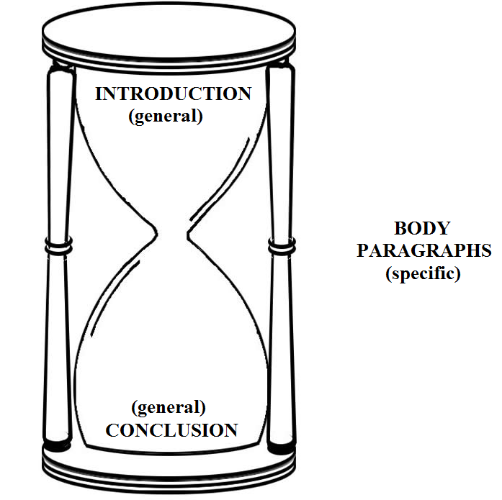
Writing Assignment II: Overview
The persuasive essay moves like an hourglass.
The first paragraph (introduction) is very general. It explores the concepts in the quote and presents your opinion on those concepts.
The middle paragraphs (body paragraphs) are more specific. They present sub-arguments and specific evidence to support your claims.
The last paragraph (conclusion) is, again, general. It wraps up your ideas and presents your overall opinion again.

Slide 14
Writing assignment iI: Steps
Determine how you feel about globalization
Analyze the quote
What is the ideology in the source?
Is the author presenting a positive or negative point of view about the ideology?
Based on your opinion, how would you respond to the quote?
Outline your essay
Write your essay
Notes:
Good mind mapping tool: https://bubbl.us/mindmap

Slide 15
Writing assignment iI: your opinion
Grade 10: Globalization
Do you like it/not like it? Why?
Write down your opinion. This WILL NOT change, regardless of the quote.
Notes:
Good mind mapping tool: https://bubbl.us/mindmap

Slide 16
Now you need to analyze the source (quote) you are given.
What perspective is it expressing?

Slide 17
We are living in an exciting time. Globalization has interconnected us - enhanced us - in ways that were unimaginable just a few decades ago. Globalization has taken us from the dark into the light.
Pro-Globalization?
Anti-Globalization?
Grade 10 – Potential Perspectives

Slide 18
Now we need to decide, based on our opinion and the quote, how to respond to the source.

Slide 19
Writing assignment iI: How to respond
 | Quote is pro-globalization | Quote is anti-globalization
You are pro-globalization | You fully embrace the source | You fully reject the source
You are anti-globalization | You fully reject the source | You fully embrace the source
You are in-between (kind of like globalization, but kind of don’t link some things about it) | You moderately embrace the source | You moderately embrace the source

Slide 20
Writing assignment iI: How to respond
Practice
based on your opinion and the quote, write down if you embrace, reject, or moderately embrace the perspective in the source
Grade 10: We are living in an exciting time. Globalization has interconnected us - enhanced us - in ways that were unimaginable just a few decades ago. Globalization has taken us from the dark into the light.

Slide 21
Now that we have our opinion, and how we are going to respond to the source decided, we need to outline our essay.

Slide 22
writing assignment iI: the formula
Introduction
Re-word the source
Develop the main perspective in the source
Explore other perspective(s) to show contrast and depth
Thesis
Body Paragraphs
Argument
Lead-In
Evidence
Conclusion
Conclusion
Re-state your thesis

Slide 23
Writing assignment iI: the introduction
Re-word the source
Explain the source in different words & identify its main perspective
“In the source, the author is saying…”, “The ideas of … can be found within the perspective of ….”, Therefore, it is clear that the author is reflecting a … perspective”
Ideology in the source
Explore the perspective of the source and the underlying ideology
Other ideologies
Using the source, transition to and explore the other perspectives
Thesis
Your response to the overall question (“To what extent should the ideology in the source be embraced?”)

Slide 24
Writing assignment Ii: the introduction
Re-word the source
Explain the source in different words & identify its main perspective
“In the source, the author is saying…”, “The ideas of … can be found within the perspective of ….”, Therefore, it is clear that the author is reflecting a … perspective”

Slide 25
Writing assignment Ii: the introduction
Re-word the source
Explain the source in different words & identify its main perspective
“In the source, the author is saying…”, “The ideas of … can be found within the perspective of ….”, Therefore, it is clear that the author is reflecting a … perspective”
Grade 10 Source
“People hoped that economic globalization would act like a rising tide that lifts all boats. Instead, it has been a riptide that has knocked over the weakest boats.”
Source - Reworded
In the source, the author is saying globalization has not been beneficial; but rather, it has been a negative force to the most disadvantaged. Due to the tone of the author’s language it is clear that he/she is expressing an anti-globalization perspective.

Slide 26
Writing assignment iI: the introduction
Re-word the source
Explain the source in different words & identify its main perspective
“In the source, the author is saying…”, “The ideas of … can be found within the perspective of ….”, Therefore, it is clear that the author is reflecting a … perspective”
Grade 10 PRACTICE Source
We are living in an exciting time. Globalization has interconnected us - enhanced us - in ways that were unimaginable just a few decades ago. Globalization has taken us from the dark into the light.
Practice Re-Wording
On Your Own!

Slide 27
Writing assignment iI: the introduction
Ideology in the source
Explore the perspective of the source and the underlying ideology
Step 1: Define the perspective
Step 2: Explore its positive characteristics
Step 3: Explore its negative characteristics
For each step – you NEED to link to the source

Slide 28
Writing assignment iI: the introduction
Ideology in the source
Explore the perspective of the source and the underlying ideology
Other ideologies
Using the source, transition to and explore the other perspectives
PERSPECTIVES/IDEOLOGIES
Grade 10: Pro v. Anti Globalization

Slide 29
Writing assignment Ii: the introduction
Ideology in the source
Other ideologies
Step 1: Define the perspective
Step 2: Explore its positive characteristics
Step 3: Explore its negative characteristics
Grade 10
Practice Source:
“People hoped that economic globalization would act like a rising tide that lifts all boats. Instead, it has been a riptide that has knocked over the weakest boats.”

Slide 30
 | Globalization
Definition | The process by which the world’s citizens are becoming increasingly connected and interdependent.
Positives | Promotes interconnectedness – allows people to travel, moves people and ideas Can create economic benefits Can encourage cultural diversity & revitalization through greater access to foreign cultures Encourages governments and organizations to work together Allows countries to specialize in what they are good at (outsourcing)
Negatives | Encourages interconnectedness – can allow the spread of diseases Can discourage diversity, and promote assimilation/homogenization Encourages outsourcing, which may lead to job loss and low wages for workers Can increase demand for goods, which can lead to environmental and social exploitation.

Slide 31
Writing assignment iI: the introduction
Thesis
Your response to the overall question
“To what extent should the ideology in the source be embraced?”
After exploring these perspectives and the positive and negative characteristics associated with the source, it is clear that the perspective of_________as reflected in the source, should be embraced _______ (minimally/moderately/fully). Instead, society would be best served by embracing the ideology of___________ (your ideology).
This is because of __________, ____________, and _____________(body paragraph arguments).

Slide 32
Writing assignment iI: Body paragraphs
Ok, now that the intro is done, we need to provide EVIDENCE to back up our thesis!

Slide 33
Writing assignment Ii: Body paragraphs
In a body paragraph, you pump up your position and you tear down every other position

Slide 34
Writing assignment iI: Body paragraphs
Grade 10: If you are…
 | Pro-Globalization | Anti-Globalization | Moderate
Body Paragraph 1 | Talks about the positives of globalization | Talks about the negatives of globalization | Talks about the positives of globalization
Body Paragraph 2 | Talks about the positives of globalization | Talks about the negatives of globalization | Talks about the negatives of globalization
Body Paragraph 3 | Recognizes one of the faults of globalization, and refutes it | Recognizes one of the benefits of globalization, and refutes it | Talks about the positives of globalization

Slide 35
Writing assignment iI: Body paragraphs
The Structure of a Body Paragraph
Sentence 1: Argument
LINK TO THE SOURCE!!!!
Broad – does not include any specific information
Sentences 2-5: Lead-In
Setting up your examples with the relevant definition and history
Sentences 6-?: Evidence
Facts, examples, and/or case studies that back up your argument
Last sentence: Conclusion
Restate your body paragraph argument, your examples, and your overall response to the essay question

Slide 36
Writing assignment iI: Body paragraphs
The Structure of a Body Paragraph
MEMORIZE your core arguments
You build these from your main facts/evidence
Link explicitly or implicitly to the source
A society that embraces “[term]” and the “[term]” leads to/creates/produces
A society that mixes “[term]” with “[term]” leads to /creates/produces
A society that completely rejects the principles of “[term]” and “[term]” will force/lead to/create/produce
Ultimately, the ideal society is produced when…
Write your arguments in a sequence
To ensure they tell a fluid and strong story

Slide 37
Writing assignment iI: Body paragraphs
Practice
Keeping your opinion in mind, build your 3-4 arguments from your source
Grade 10: We are living in an exciting time. Globalization has interconnected us - enhanced us - in ways that were unimaginable just a few decades ago. Globalization has taken us from the dark into the light.

Slide 38
Writing assignment iI: conclusion
Your conclusion is the EASIEST part of the essay.
It should take you less than a minute.
“In conclusion, it is clear that
[thesis paragraph]”

